Slide 1


GE100 - Application of Information and Communication Technologies
Lec # 8: Introduction to Web Technologies
(HTML, CSS and JavaScript)
Instructor: Alina Maryum

Slide 2
Introduction
Your Code
When you decide to develop an application using any programming language, one of the first problem you face is that programming languages do not include a library to create User Interfaces.
You need to use some framework to access the OS layer. Every programming language has at least one, but you need to choose it first.
Framework
Operative System
Hardware

Slide 3
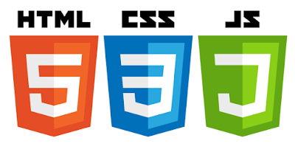
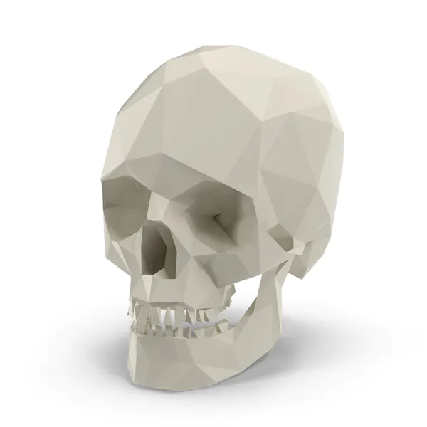


Goals
Introduction to web technologies:
HTML to create the document structure and content
CSS to control is visual aspect
Javascript for interactivity

Slide 4
Tools
What do we need to start:
a good web-browser (Chrome or Firefox)
a good text editor like:
VSCode (cross platform)
Notepad++ (win)
textWrangler (osx)
sublime text (cross platform)
ecode (cross platform)
the example HTML code to start

Slide 5
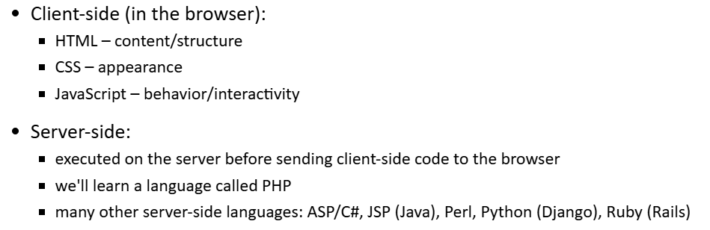
Technologies
HTML
CSS
Javascript

Slide 6
HTML
HTML means Hyper Text Markup Language.
The HTML allow us to define the structure of a document or a website.
HTML is NOT a programming language, it’s a markup language, which means its purpose is to give structure to the content of the website, not to define an algorithm.
It is a series of nested tags (it is a subset of XML) that contain all the website information (like texts, images and videos). Here is an example of tags:
<title>This is a title</title>
The HTML defines the page structure. A website can have several HTMLs to different pages.
<html>
<head>
</head>
<body>
<div> <p>Hi</p>
</div>
</body>
</html>

Slide 7
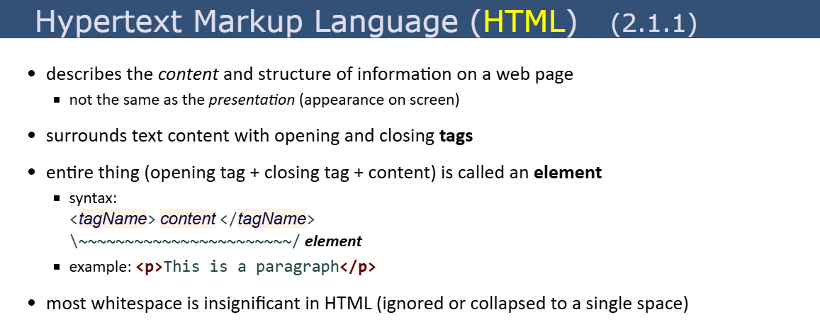

Slide 8
HTML: basic rules
Some rules about HTML:
It uses XML syntax (tags with attributes, can contain other tags).
<tag_name attribute="value"> content </tag_name>
It stores all the information that must be shown to the user.
There are different HTML elements for different types of information and behaviour.
The information is stored in a tree-like structure (nodes that contain nodes inside) called DOM (Document Object Model).
It gives the document some semantic structure (pe. this is a title, this is a section, this is a form) which is helpful for computers to understand websites content.
It must not contain information related to how it should be displayed (that information belongs to the CSS), so no color information, font size, position, etc.

Slide 9
HTML: syntax example
<div id="main">
<!-- this is a comment -->
This is text without a tag.
<button class="mini">press me</button>
<img src="me.png" />
</div>

Slide 10
HTML: syntax example
Tag name
<div id="main">
<!-- this is a comment -->
This is text without a tag.
<button class="mini">press me</button>
<img src="me.png" />
</div>
attributes
comment
text tag
self-closing tag

Slide 11
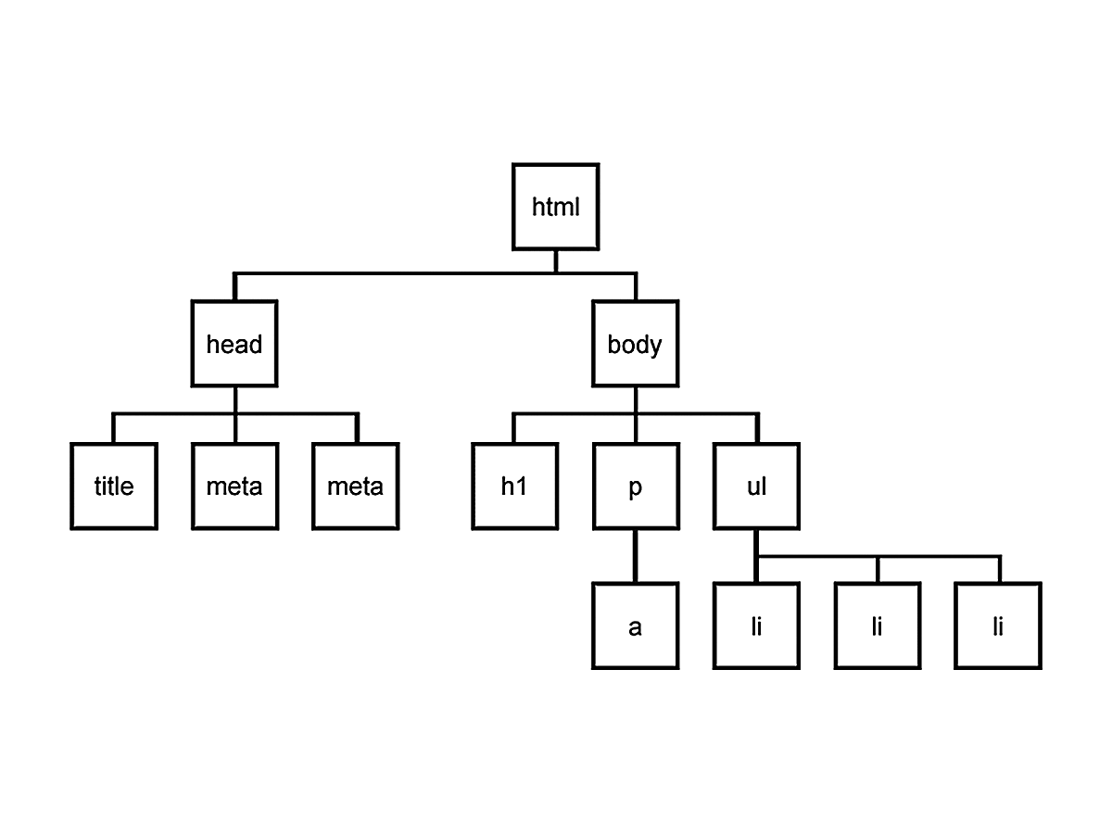
DOM is a tree
Every node can only have one parent, and every node can have several children, so the structure looks like a tree.

Slide 12
HTML: main tags
Although there are lots of tags in the HTML specification, 99% of the webs use a subset of HTML tags with less that 10 tags, the most important are:
<div>: a container, usually represents a rectangular area with information inside.
<img/>: an image
<a>: a clickable link to go to another URL
<p>: a text paragraph
<h1>: a title (h2,h3,h4 are titles of less importance)
<input>: a widget to let the user introduce information
<style> and <link>: to insert CSS rules
<script>: to execute Javascript
<span>: a null tag (doesn't do anything), good for tagging info

Slide 13
HTML: other interesting tags
There are some tags that could be useful sometimes:
<button>: to create a button
<audio>: for playing audio
<video>: to play video
<canvas>: to draw graphics from javascript
<iframe>: to put another website inside ours

Slide 14
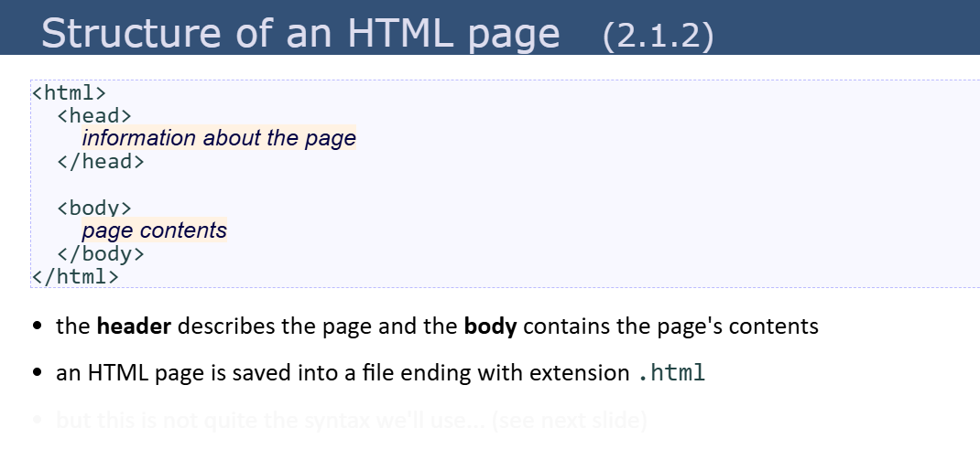

Slide 15
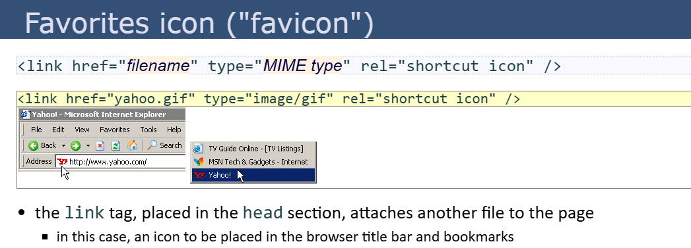

Slide 16
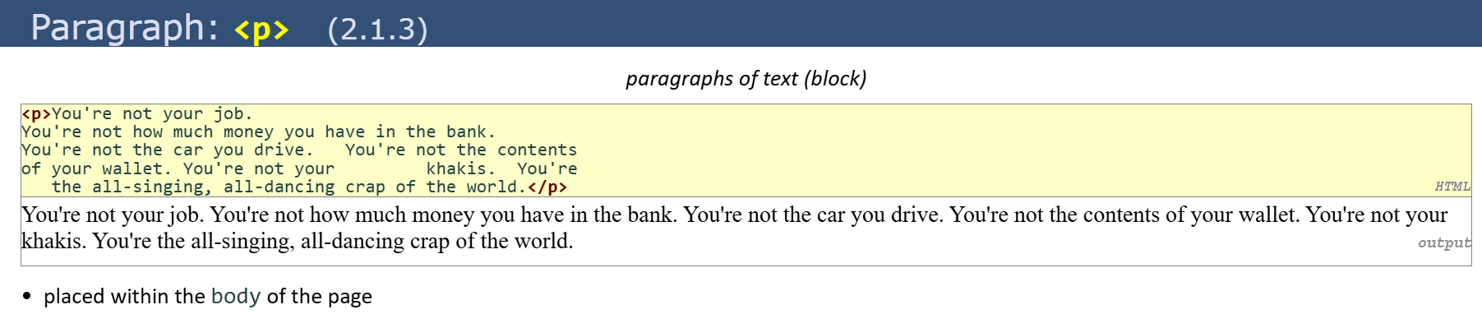
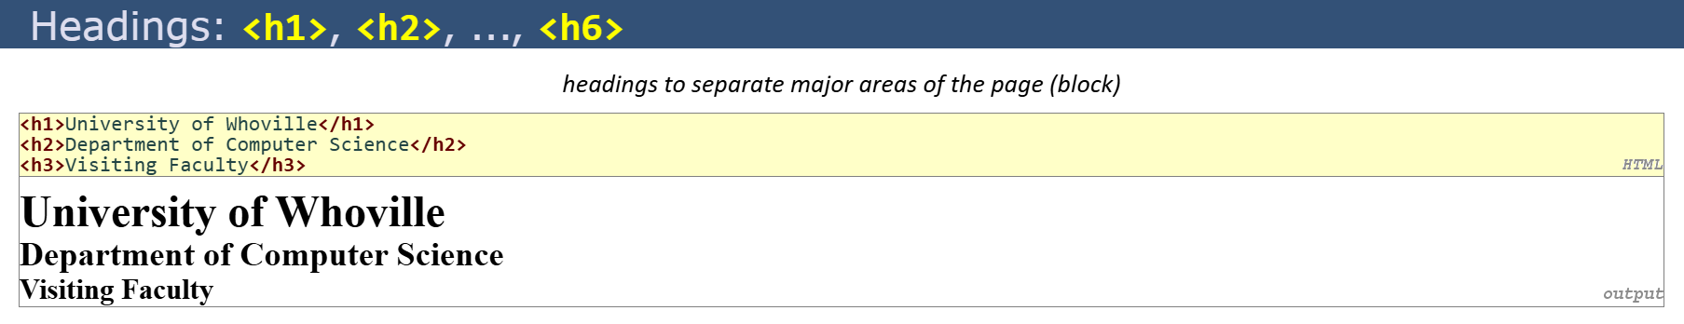

Slide 17
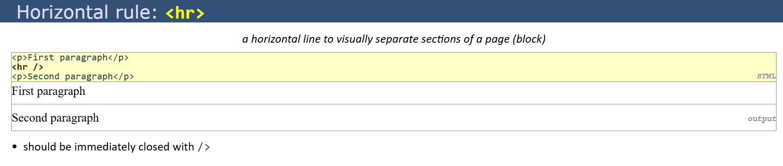
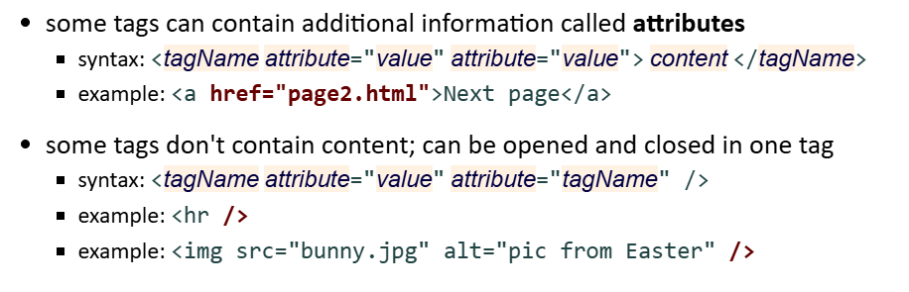

Slide 18
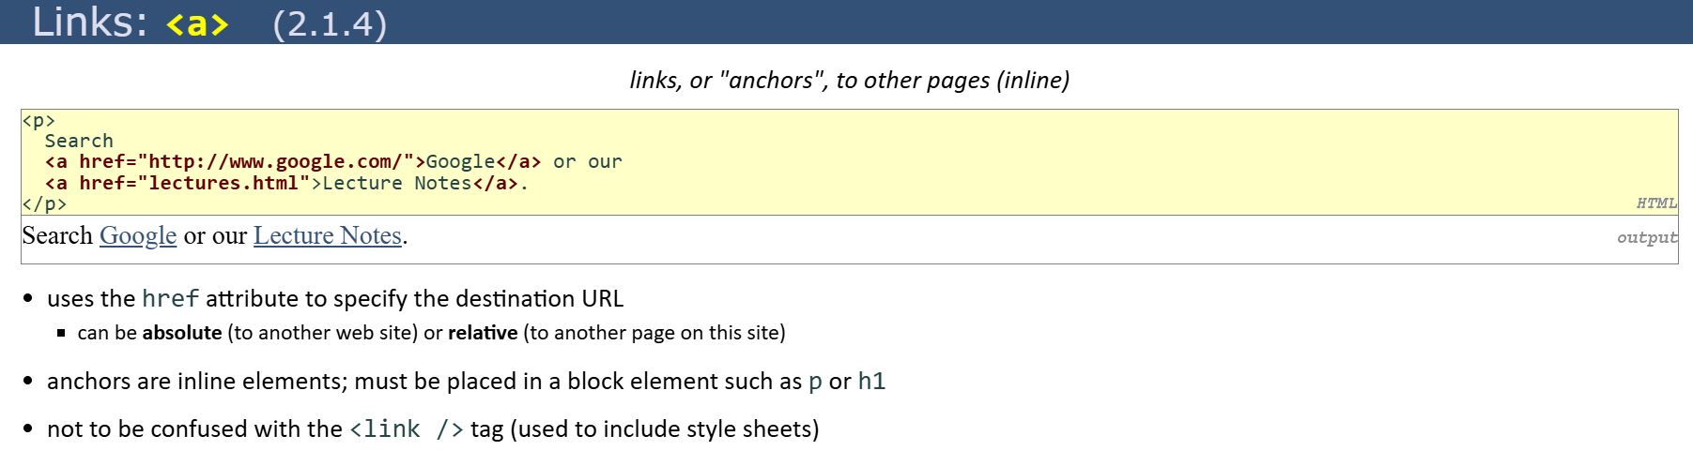
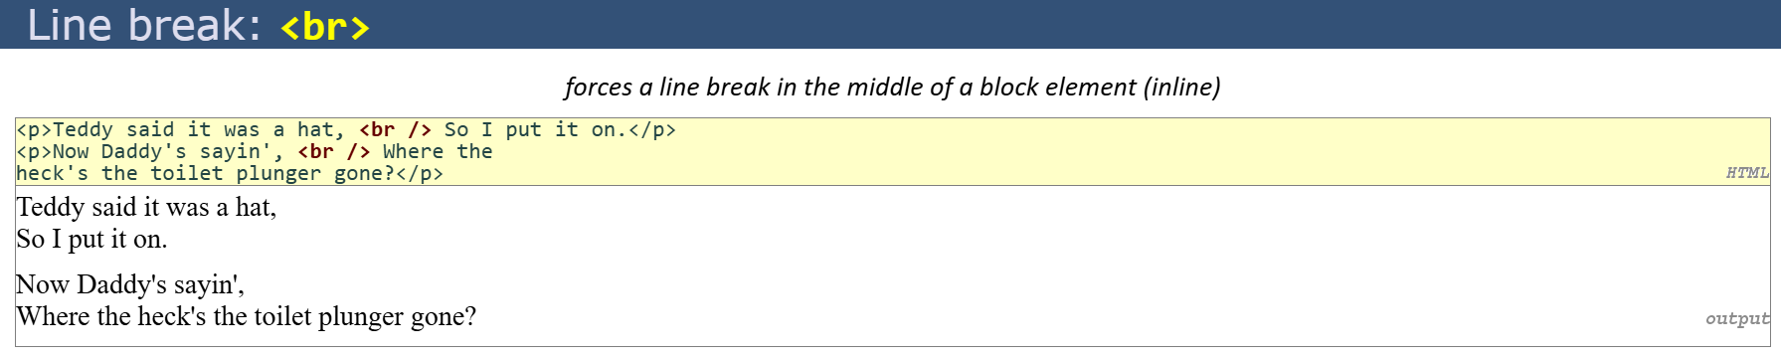

Slide 19
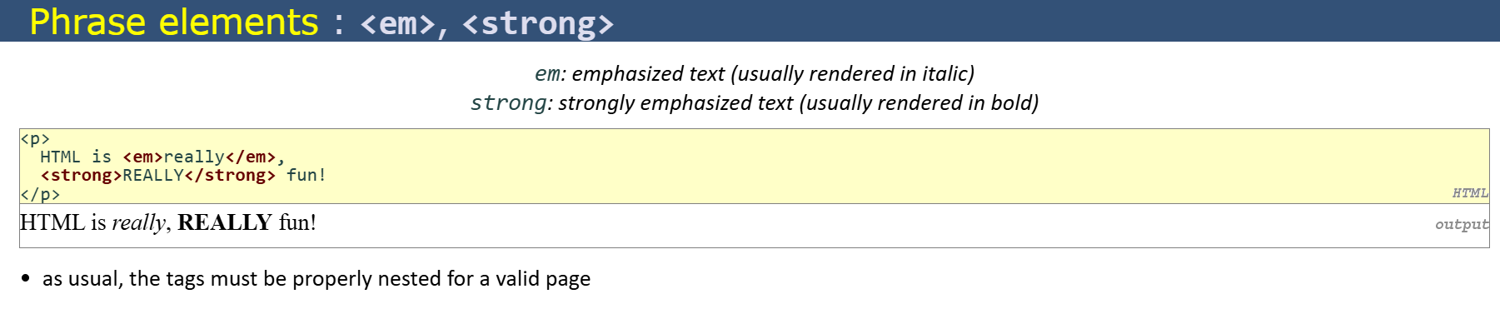
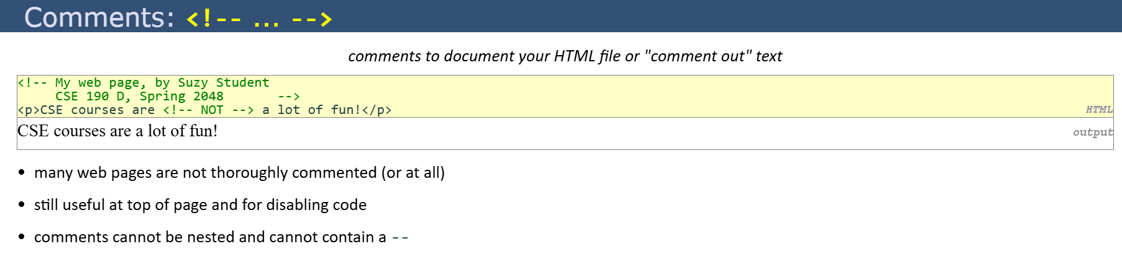

Slide 20
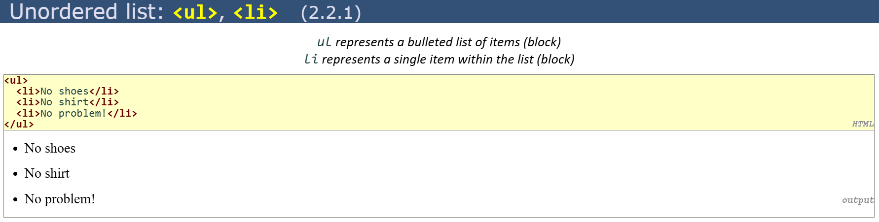
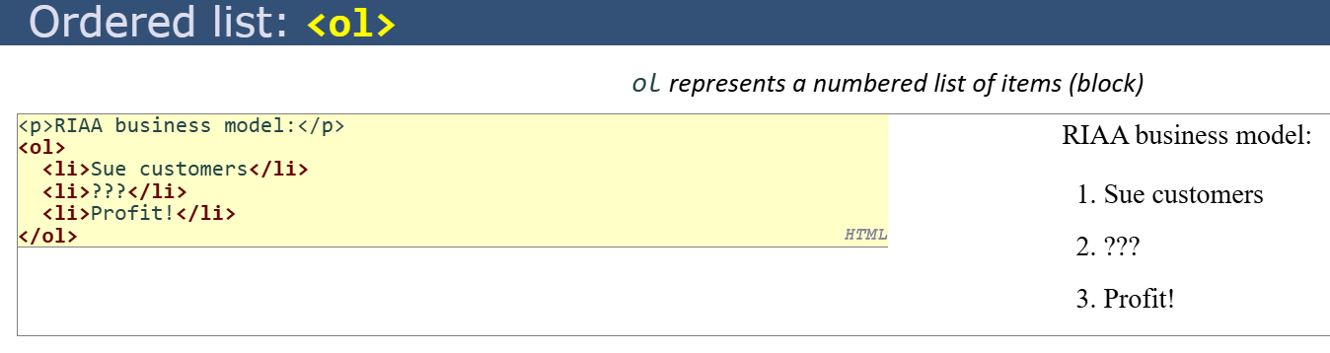

Slide 21
HTML good use
It is good to have all the information properly wrapped in tags that give it some semantics.
We also can extend the code semantics by adding extra attributes to the tags:
id: tells a unique identifier for this tag
class: tells a generic identifier for this tag
<div id="profile-picture" class="mini-image">...</div>

Slide 22
HTML references
HTML Reference: a description of all HTML tags.
The 25 Most used tags: a list with information of the more common tags.
HTML5 Good practices: some tips for starters

Slide 23
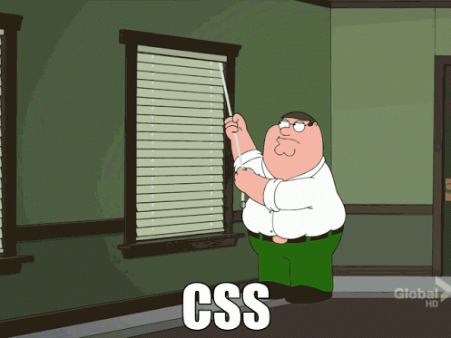
Technologies
HTML
CSS
Javascript

Slide 24
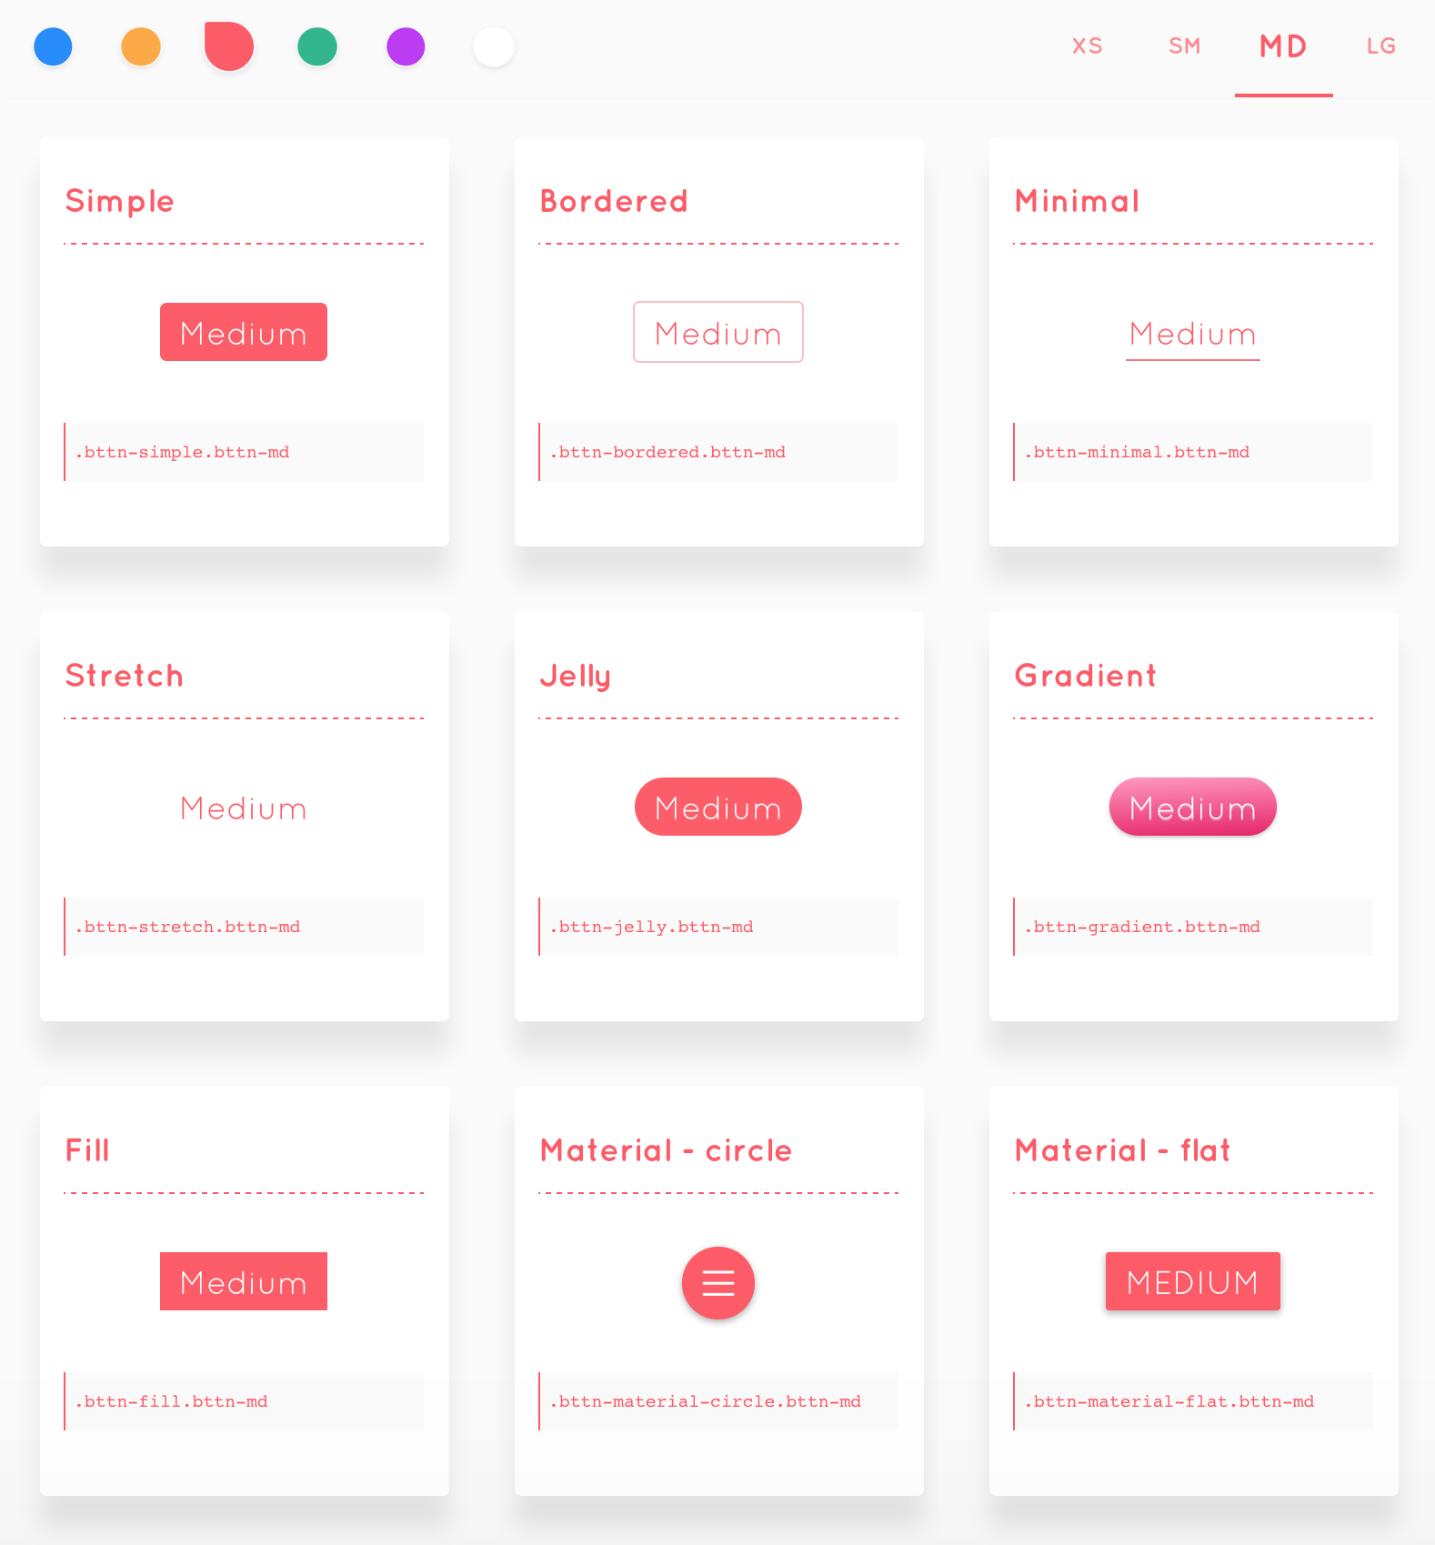
CSS
CSS allows us to specify how to present (render) the document info stored in the HTML.
Thanks to CSS we can control all the aspects of the visualization and some other features:
Colors: content, background, borders
Margins: interior margin, exterior margin
Position: where to put it
Sizes: width, height
Behaviour: changes on mouse over

Slide 25
CSS example
* {
color: blue; /*a comment */
margin: 10px;
font: 14px Tahoma;
}
This will change all the tags in my web ( ‘*‘ means all) to look blue with font Tahoma with 14px, and leaving a margin of 10px around.

Slide 26
CSS fields
Here is a list of the most common CSS fields and an example:
color: #FF0000; red; rgba(255,00,100,1.0); //different ways to specify colors
background-color: red;
background-image: url('file.png');
font: 18px 'Tahoma';
border: 2px solid black;
border-top: 2px solid red;
border-radius: 2px; //to remove corners and make them more round
margin: 10px; //distance from the border to the outer elements
padding: 2px; //distance from the border to the inner elements
width: 100%; 300px; 1.3em; //many different ways to specify distances
height: 200px;
text-align: center;
box-shadow: 3px 3px 5px black;
cursor: pointer;

Slide 27
CSS how to add it
There are four ways to add CSS rules to your website:
Inserting the code inside a style tag
<style>
p { color: blue }
</style>
Referencing an external CSS file
<link href="style.css" rel="stylesheet" />
Using the attribute style on a tag
<p style="color: blue; margin: 10px">

Slide 28
CSS selectors
Let's start by changing the background color of one tag of our website:
div { background-color: red; }
This CSS rule means that every tag DIV found in our website should have a red background color. Remember that DIVs are used mostly to represent areas of our website.
We could also change the whole website background by affecting the tag body:
body { background-color: red; }

Slide 29
CSS selectors
What if we want to change one specific tag (not all the tags of the same type).
We can specify more precise selectors besides the name of the tag. For instance, by class or id. To specify a tag with a given class name, we use the dot:
p.intro { color: red; }
This will affect only the tags p with class name intro:
<p class="intro">

Slide 30
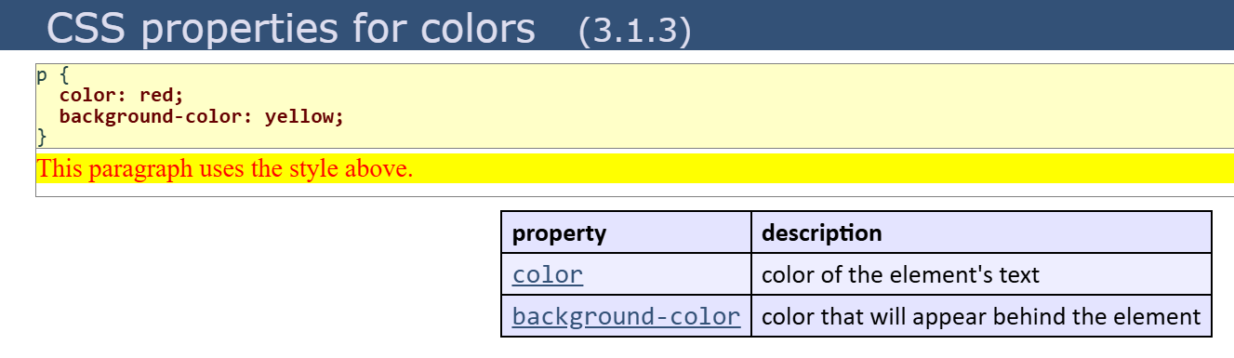
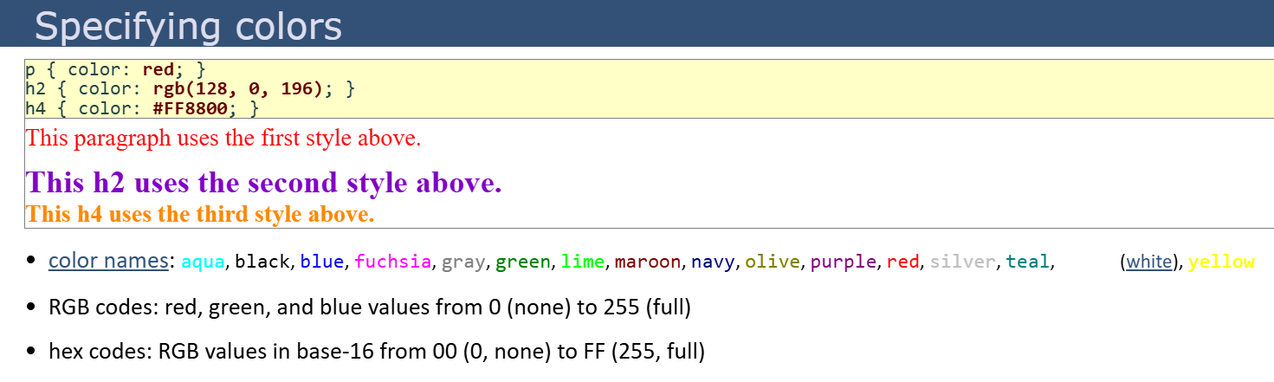

Slide 31
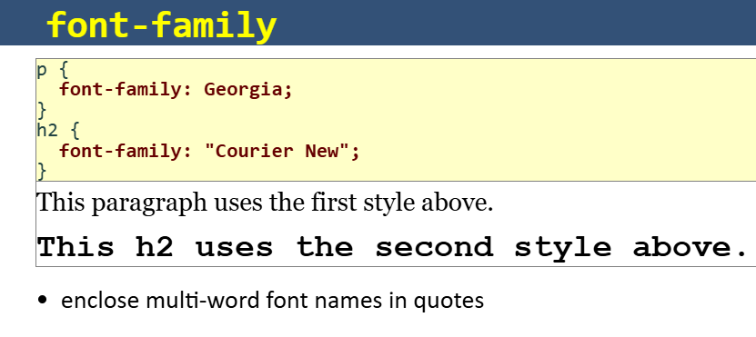
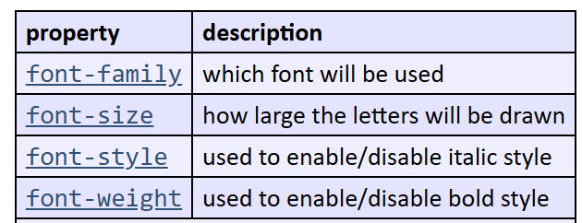
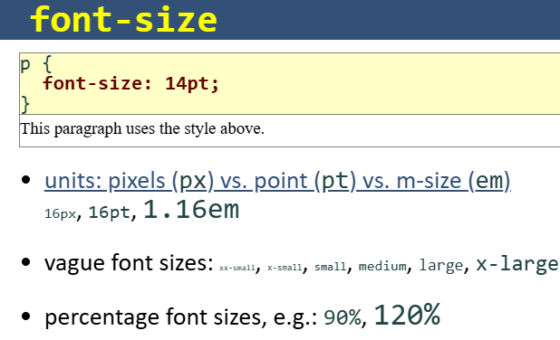
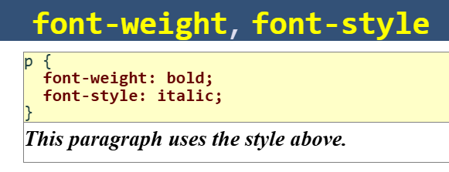

Slide 32
CSS Selectors
There are several selectors we can use to narrow our rules to very specific tags of our website.
The main selectors are:
tag name: just the name of the tag
p { ... } //affects to all <p> tags
dot (.): affects to tags with that class
p.highlight { ... } //affects all <p> tags with class="highlight"
sharp character (#): specifies tags with that id
p#intro { ... } //affects to the <p> tag with the id="intro"
two dots (:): behaviour states (mouse on top)
p:hover { ... } //affects to <p> tags with the mouse over

Slide 33
CSS Selectors
You can also specify tags by its context, for example: tags that are inside of tags matching a selector. Just separate the selectors by an space:
div#main p.intro { ... }
This will affect to the p tags of class intro that are inside the tag div of id main
<div id="main"> <p class="intro">....</p> ← Affects this one </div>
<p class="intro">....</p> ← but not this one

Slide 34
CSS Selectors
And you can combine selectors to narrow it down more.
div#main.intro:hover { ... }
will apply the CSS to the any tag div with id main and class intro if the mouse is over.
And you do not need to specify a tag, you can use the class or id selectors without tag, this means it will affect to any node of id main
#main { ... }

Slide 35
CSS Selectors
If you want to select only elements that are direct child of one element (not that have an ancestor with that rule), use the > character:
ul.menu > li { ... }
Finally, if you want to use the same CSS actions to several selectors, you can use the comma , character:
div, p { … } ← this will apply to all divs and p tags

Slide 36
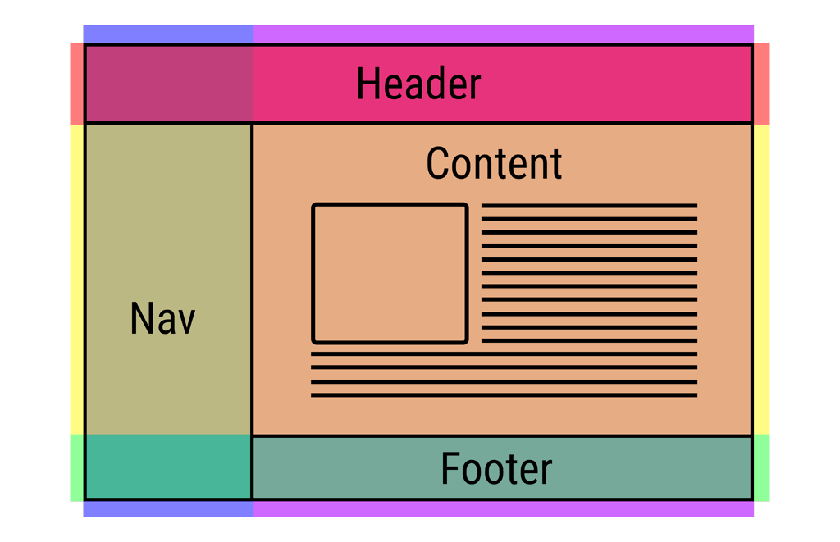
Layout
One of the hardest parts of CSS is construing the layout of your website (the structure inside the window) .
By default HTML tends to put everything in one column, which is not ideal.
There has been many proposals in CSS to address this issue (tables, fixed divs, flex, grid, …).

Slide 37
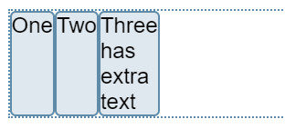
Flexbox
The first big proposal to address the layout was the flexbox model.
This model allows to arrange stuff in one direction (vertically or horizontally) very easily.
You can even choose to arrange from right to left (reverse).
It can also be used to arrange a series of elements in different rows.
Check the tutorial for more info.
HTML
<div class="box">
<div>One</div>
<div>Two</div>
<div>Three
<br>first line
<br>second line
</div>
</div>
CSS
.box {
display: flex;
}

Slide 38
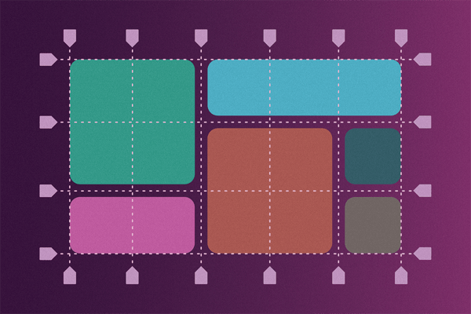
Grid system
HTML
<div class="grid-container">
<div class="grid-item1">1</div>
<div class="grid-item2">2</div>
</div>
CSS
.grid-container {
display: grid;
grid-template-rows: 100px 100px;
grid-template-columns: 100px 100px 100px;
grid-gap: 5px;
}
.grid-item1 {
background: blue;
border: black 5px solid;
grid-column-start: 1;
grid-column-end: 5;
grid-row-start: 1;
grid-row-end: 3;
}
We just assign how many rows/columns a div should use from the main grid and it will arrange automatically.
Check this tutorial to create the site structure easily

Slide 39
Fullscreen divs
CSS
html, body {
width: 100%;
height: 100%;
}
div {
margin: 0;
padding: 0;
}
#main {
width: 100%;
height: 100%;
}
Sometimes we want to have a div that covers the whole screen (to make a webapp), instead of a scrolling website (more like regular documents).
In that case remember to use percentages to define the size of elements, but keep in mind that percentages are relative to the element's parent size, so you must set the size to the <body> and <html> element to use 100%.

Slide 40
Trick to center
Centering divs can be hard sometimes, use this trick:
horizontal-and-vertical-centering {
display: flex;
justify-content: center;
align-items: center;
}

Slide 41
CSS further reading
There are many more rules for selectors.
Check some of the links to understand them better.
One line layouts tutorials
Understanding the Box Model: a good explanation of how to position the information on your document.
All CSS Selectors: the CSS selectors specification page.
CSS Transition: how to make animations just using CSS
TailwindCSS: a CSS Framework

Slide 42
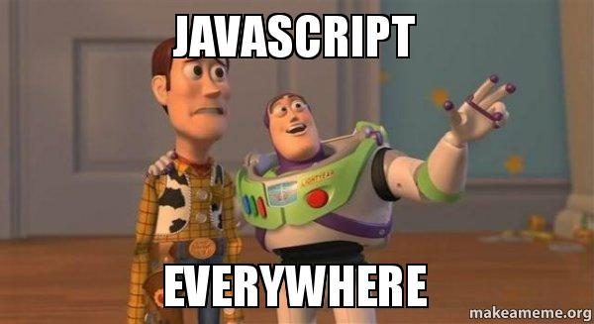
Technologies
HTML
CSS
Javascript

Slide 43
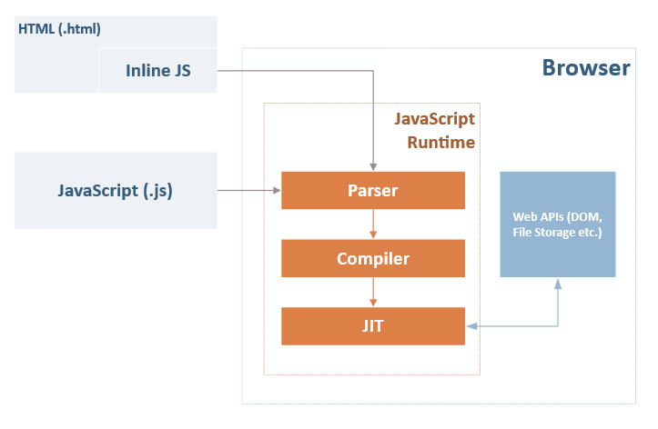
Interactivity
Once the web was already being used they realize people wanted to interact with the websites in a more meaningful way.
So they added an Interpreter to execute a script language that could modify the content of the web dynamically.
Brendan Eich was tasked to develop it in one week and it has become one of the most important languages.

Slide 44
Javascript
var my_number = 10; function say( str ) { console.log( str ); }
say("hello");
A regular programming language, easy to start, hard to master.
Allows to give some interactivity to the elements on the web.
Syntax similar to C or Java but with no types.
You can change the content of the HTML or the CSS applied to an element.
You can even send or retrieve information from the internet to update the content of the web without reloading the page.

Slide 45
Javascript: insert code
There is three ways to execute javascript code in a website:
Embed the code in the HTML using the <script> tag.
<script> /* some code */ </script>
Import a Javascript file using the <script> tag:
<script src="file.js" />
Inject the code on an event inside a tag:
<button onclick="javascript: /*code*/">press me</button>

Slide 46
Javascript: Syntax
Very similar to C++ or Java but much simpler.
var my_number = 10; //this is a comment var my_string = "hello"; var my_array = [10,20,"name",true]; var my_object = { name: "javi", city: "Barcelona" }; function say( str ) { for(var i = 0; i < 10; ++i) console.log(" say: " + str ); }

Slide 47
Javascript example
<html>
<body>
<h1>This is a title</h1>
<script>
var title = document.querySelector("h1");
title.innerHTML = "This is another title";
</script>
</body>
</html>

Slide 48
Javascript: retrieving element
You can get elements from the DOM (HTML tree) using different approaches.
Using a selector (like in CSS)
Attaching events listeners (calling functions when some actions are performed)

Slide 49
Javascript: using selectors
You can retrieve elements using selectors:
var mynode = document.querySelectorAll("p.intro");
will return an array with all <p class="intro"> nodes in the web.

Slide 50
Javascript: modify nodes
From JS you can change the attributes
mynode.id = "intro"; //sets an id
mynode.className = "important"; //set class
mynode.classList.add("good"); //to add to the current classes
Change the content
mynode.innerHTML = "<p>text to show</p>"; //change content
Modify the style (CSS)
mynode.style.color = "red"; //change any css properties
or add the behaviour of a node
mynode.addEventListener("click", function(e) {
//do something
});

Slide 51
Javascript: hide and show elements
Sometimes it may be useful to hide one element or show another.
You can change an element CSS directly by accessing its property style.
To avoid being displayed on the web change display to "none"
element.style.display = "none"; //hides elements from being rendered element.style.display = "block"; //displays it again

Slide 52
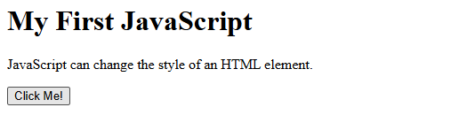
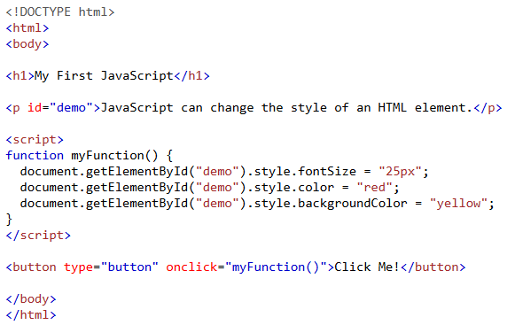
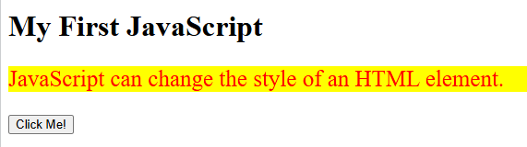
Example
Before Clicking
After Clicking

Slide 53
Using Inputs
If you want the user to be able to input some text we use the tag <input>:
<input type="text"/>
From Javascript we can attach events like "click" or "keydown".
To read or modify the content of the input:
my_input_element.value = ""; //this will clear the text inside the input

Slide 54
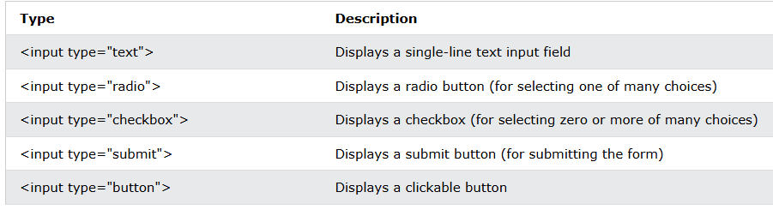
Input types

Slide 55
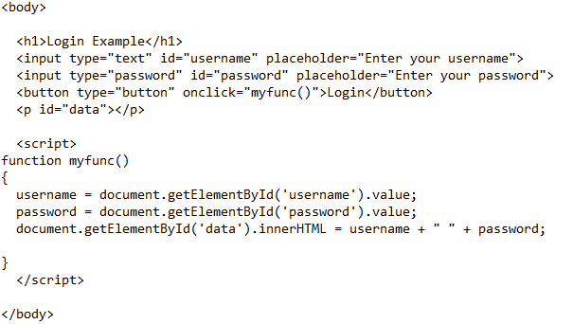
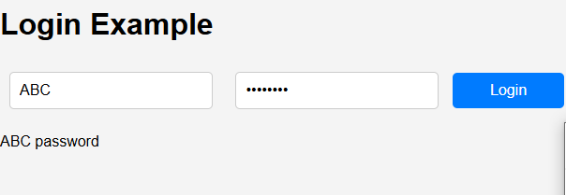
Example

Slide 56
Example of a website
HTML in index.html
<link href="style.css" rel="stylesheet"/>
<h1>Welcome</h1>
<p>
<button>Click me</button>
</p>
<script src="code.js"/>
Javascript in code.js
//fetch the button from the DOM
var button = document.querySelector("button");
//attach and event when the user clicks it
button.addEventListener("click", myfunction);
//create the function that will be called when the button is pressed
function myfunction()
{
//this shows a popup window
alert("button clicked!");
}
CSS in style.css
h1 { color: #333; }
button {
border: 2px solid #AAA;
background-color: #555;
}

Slide 57
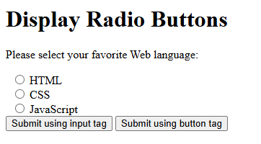
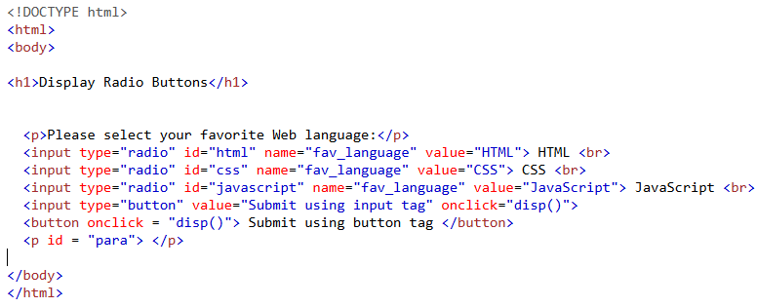
Radio Buttons
<input type="radio"/>

Slide 58
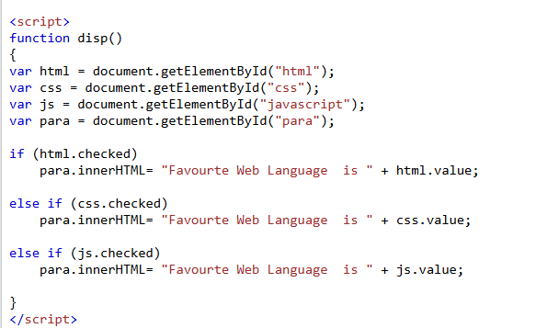
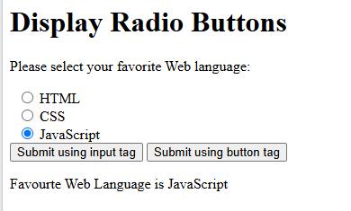
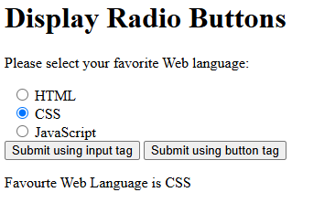
Cont..

Slide 59
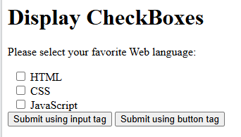
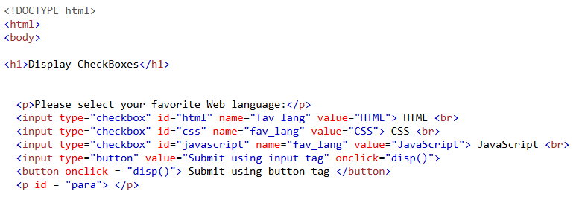
Checkbox
<input type="checkbox"/>

Slide 60
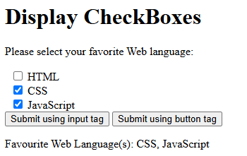
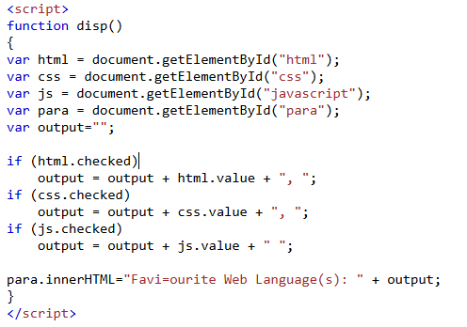
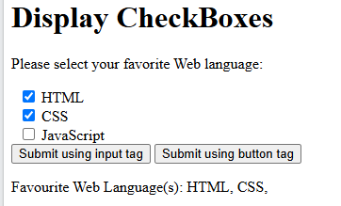
Cont..

Slide 61
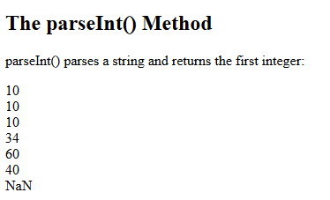
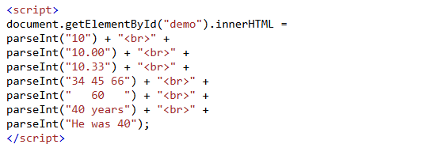
Conversion / Parsing
The parseFloat() method parses a value as a string and returns first floating number.
The parseInt() method parses a value as a string and returns the first integer.

Slide 62
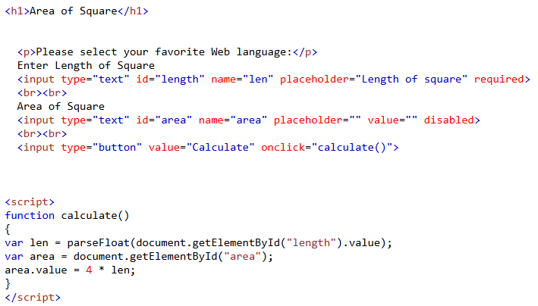
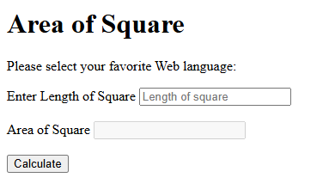

Example (parsing, required and disabled)

Slide 63
Input types
Explore the use of following Input type
Password
Email
number

Slide 64

Assignment # 4
Create the layout for a messaging application.
Structured like:
Main container
Messages area
message
Typing area area
input

